Slide 1
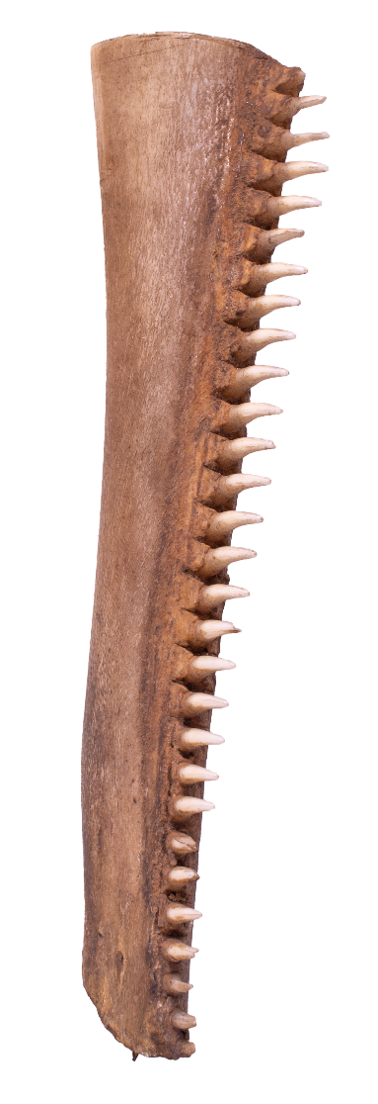

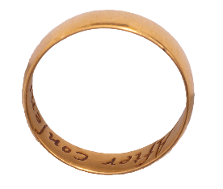
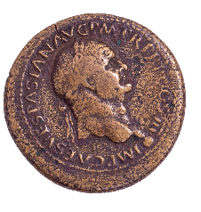
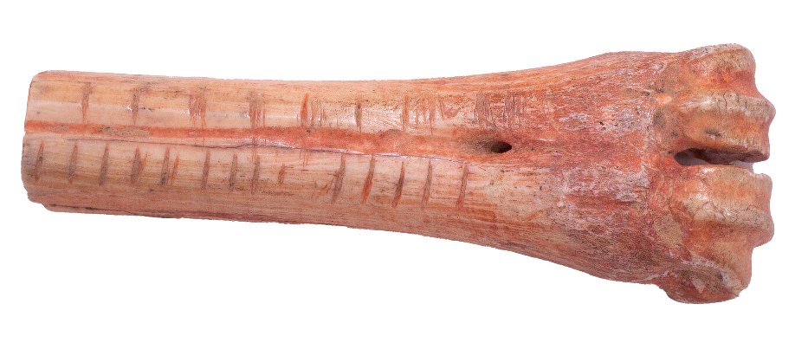
Uncovering local history and Cynefin:
Conwy Culture Centre Museum Store

Slide 2
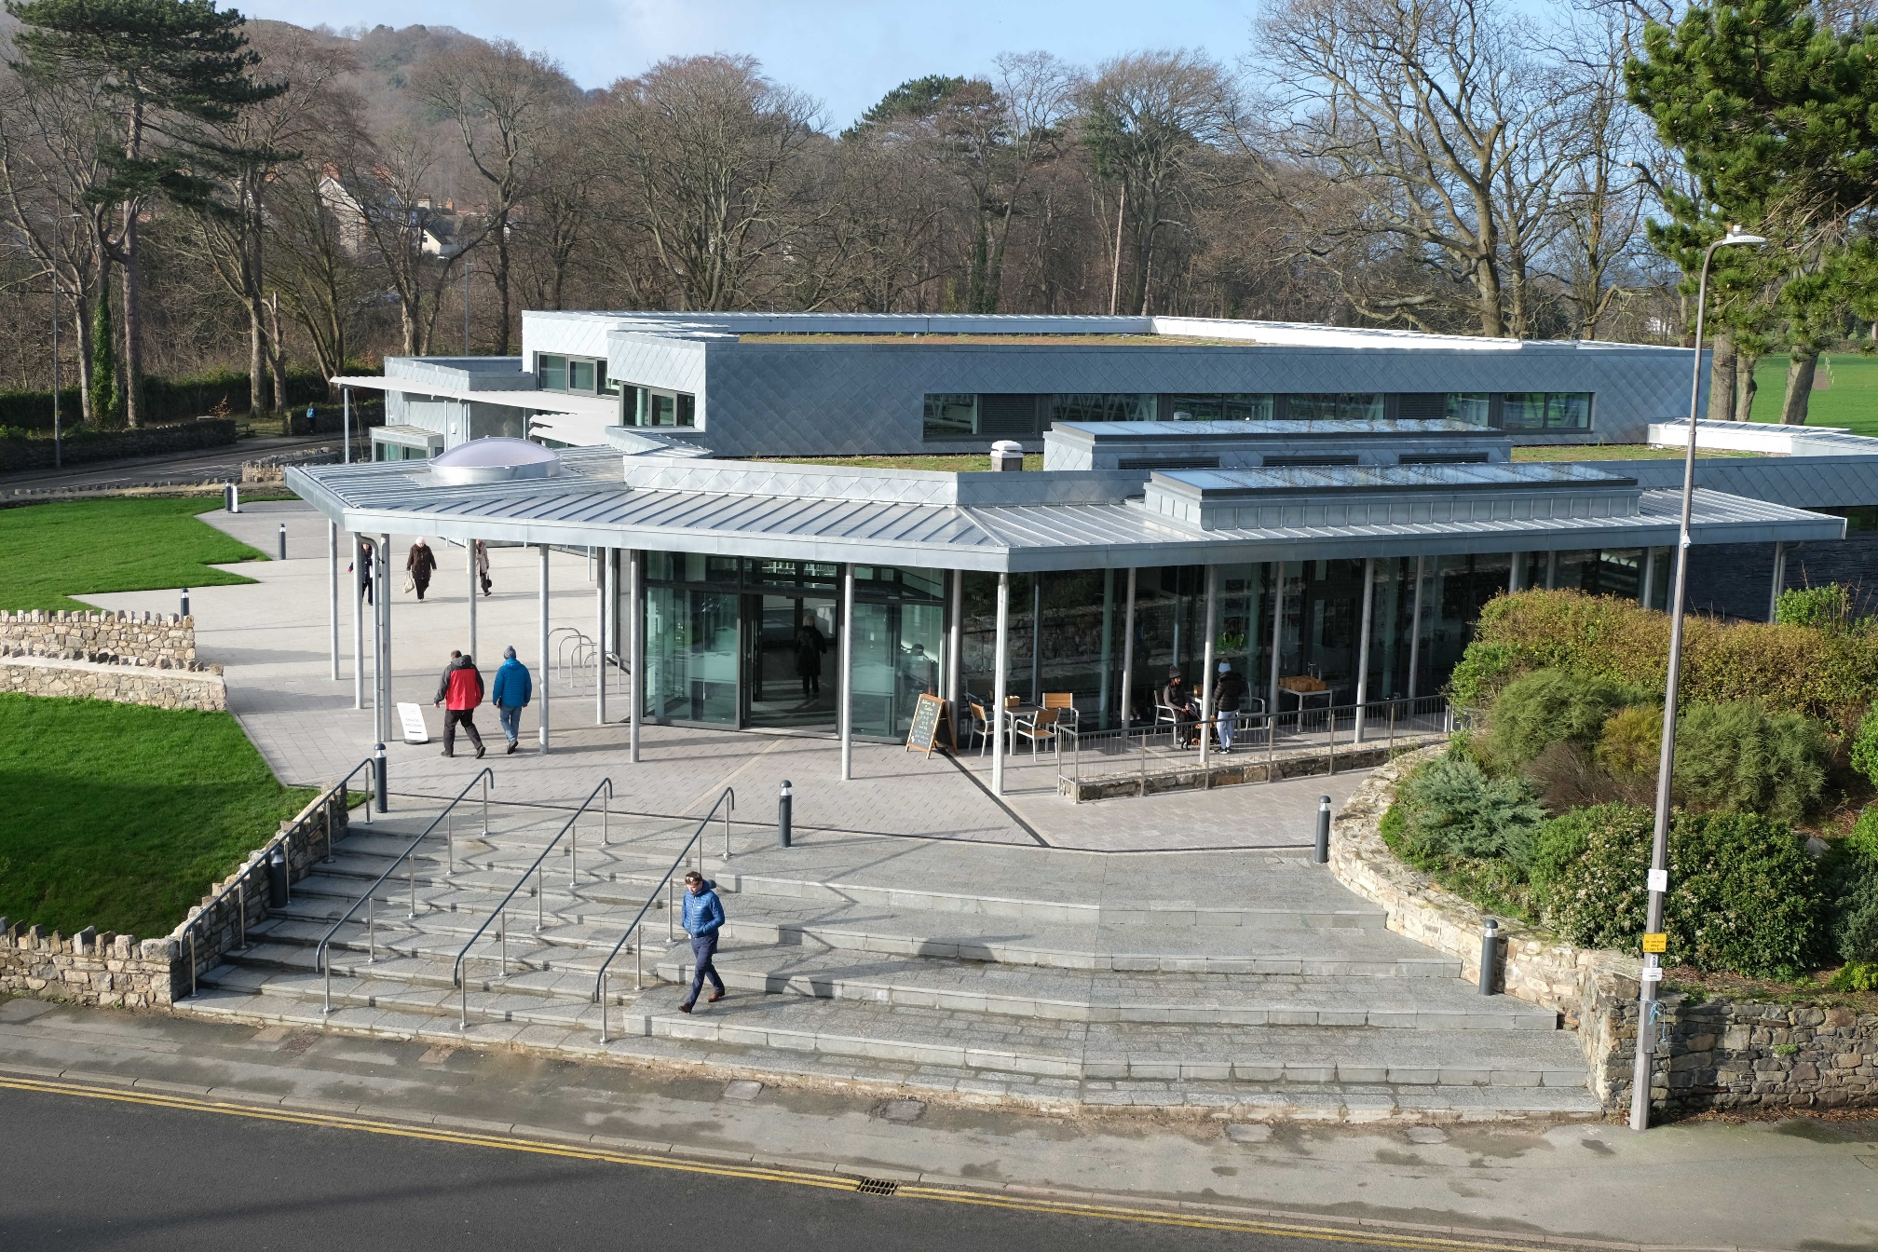
Conwy Culture Centre
Conwy Culture Centre
Conwy Culture Centre

Slide 3
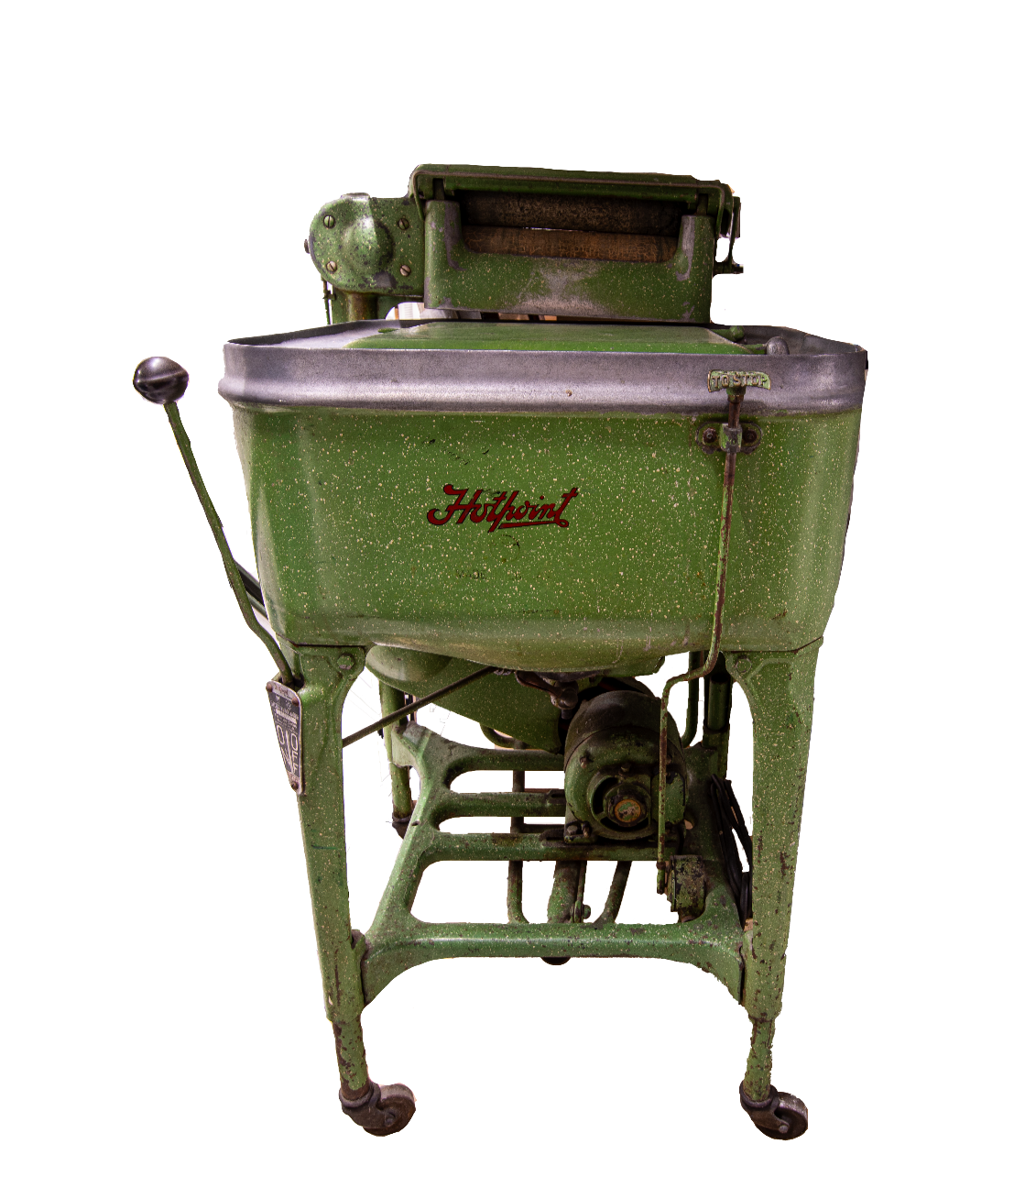
Mysteries
What is the object and what is it used for?
Washing Machine

Slide 4
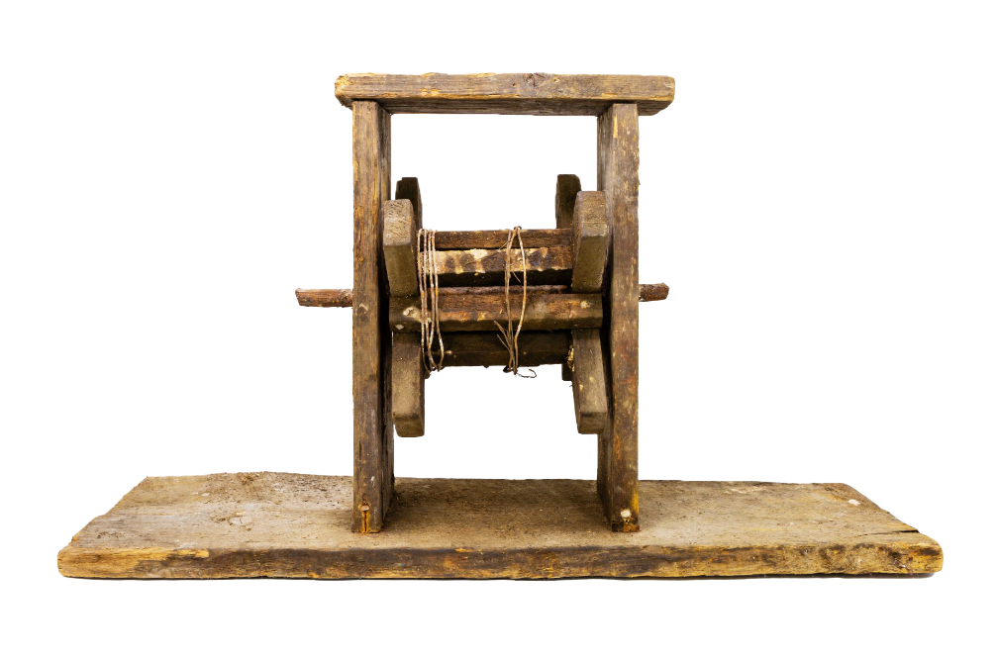
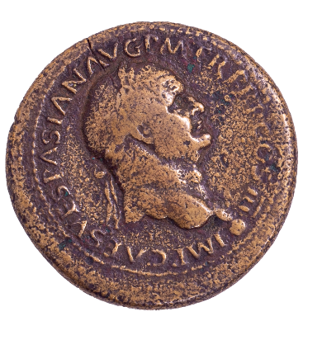
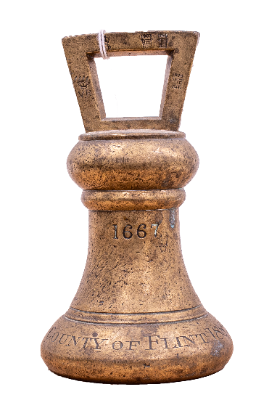
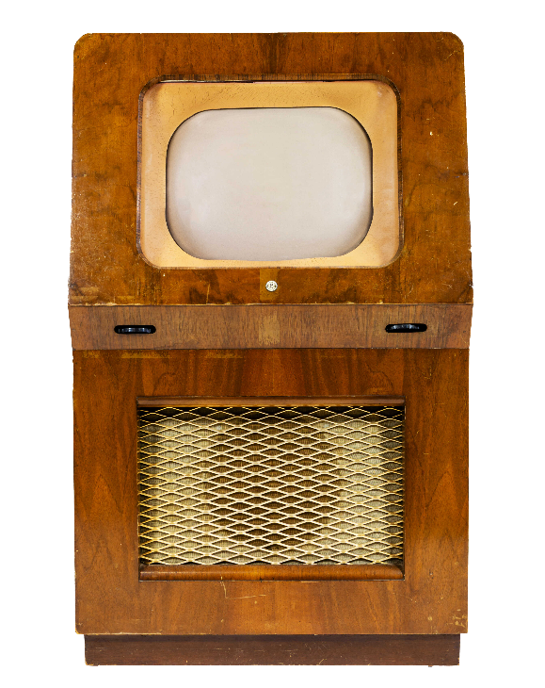
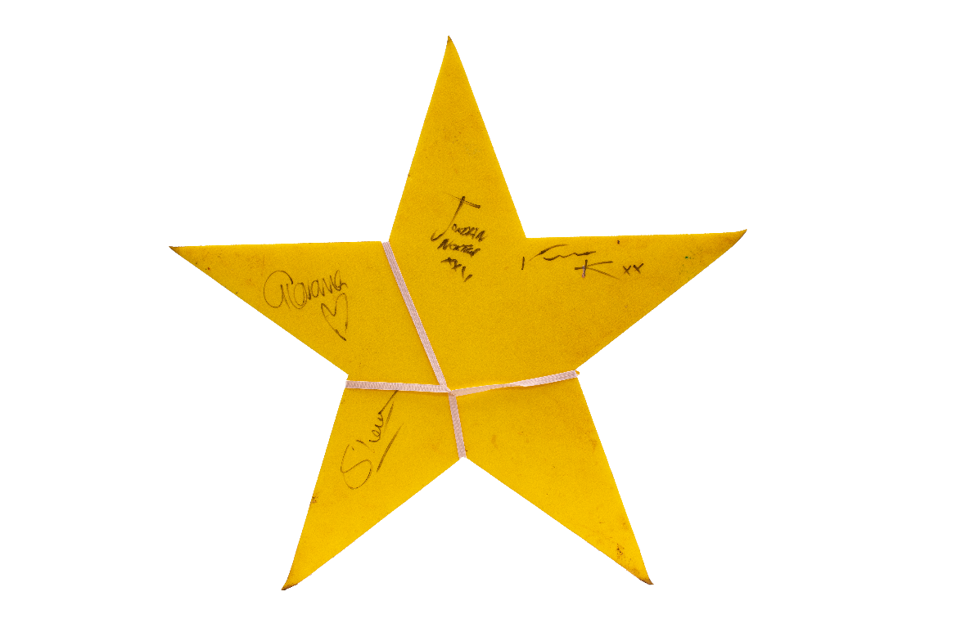
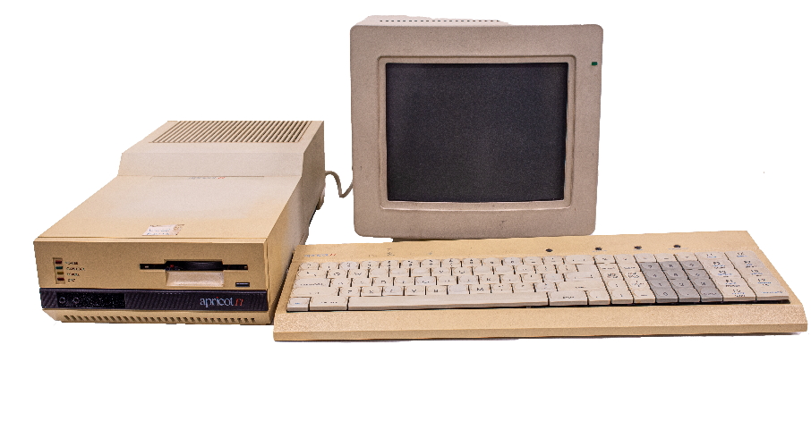
Mysteries
Mining, explosive reel, early 20th Century
5
What is the object and what is it used for?
4
Weight 1882
3
TV 1953
1
Roman coin: Vespasian 69-71 AD
6
I’m a Celeb Star
2020
2
Apricot Computer 1984

Slide 5
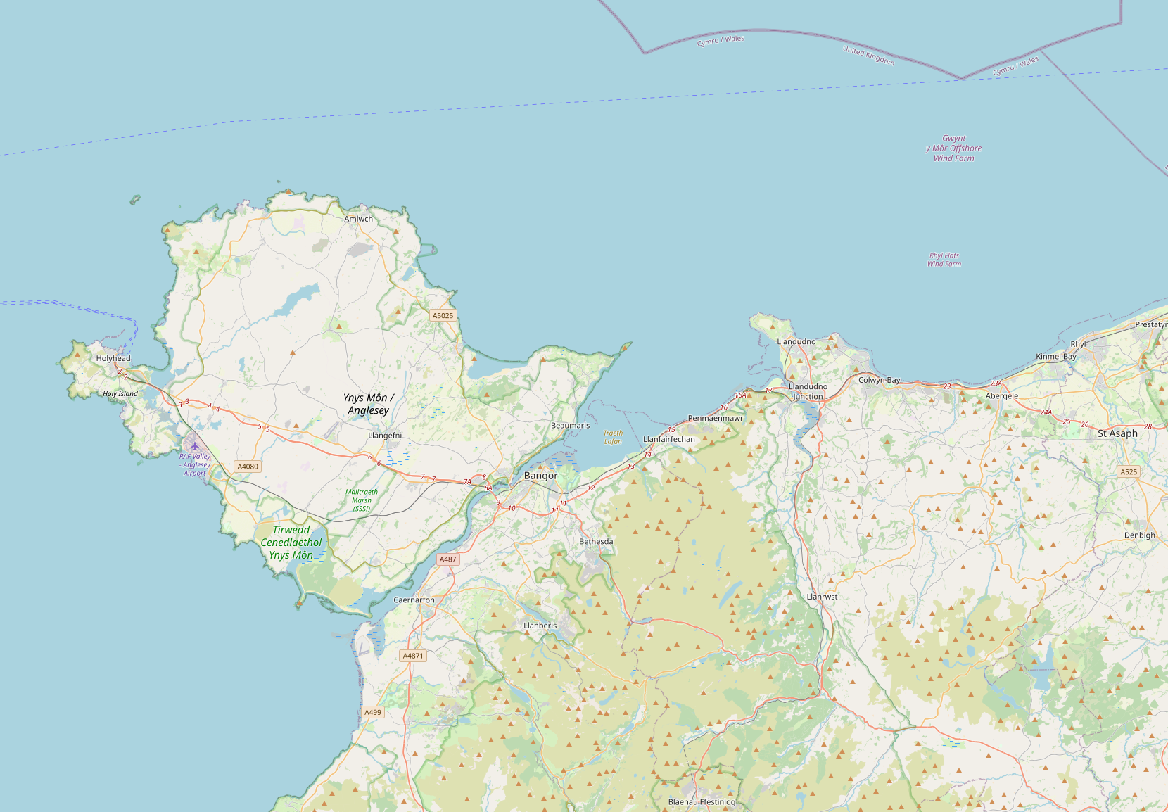
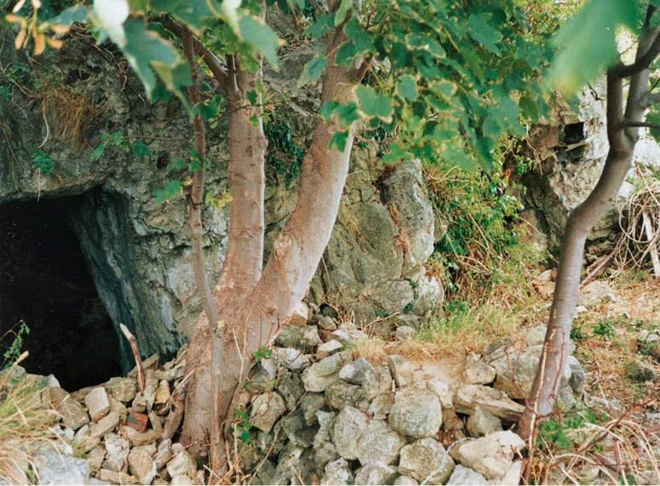
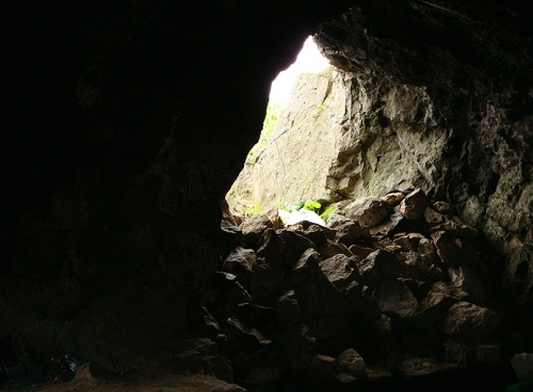
Places
Kendrick’s Cave - What happened here?
Kendrick’s Cave
Conwy
Abergele

Slide 6

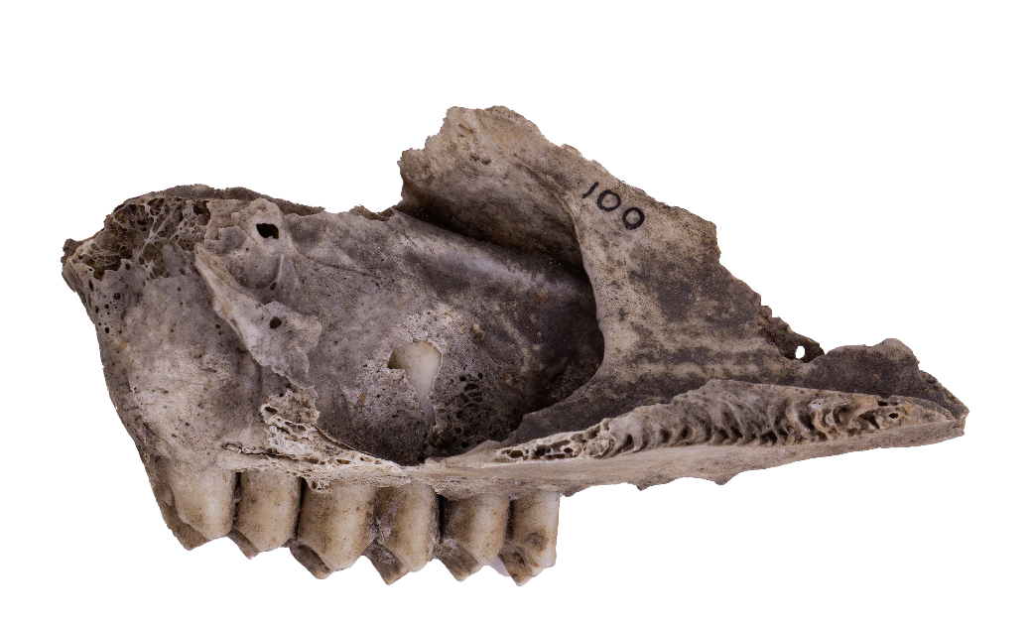
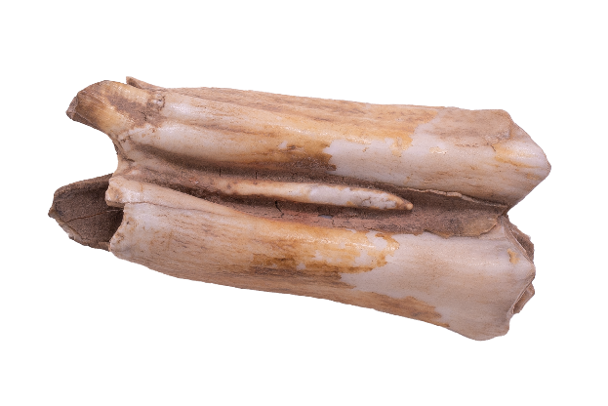
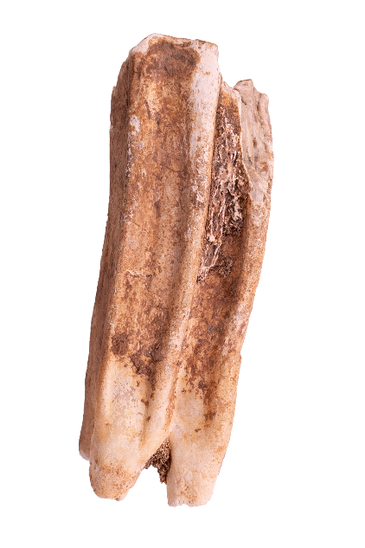
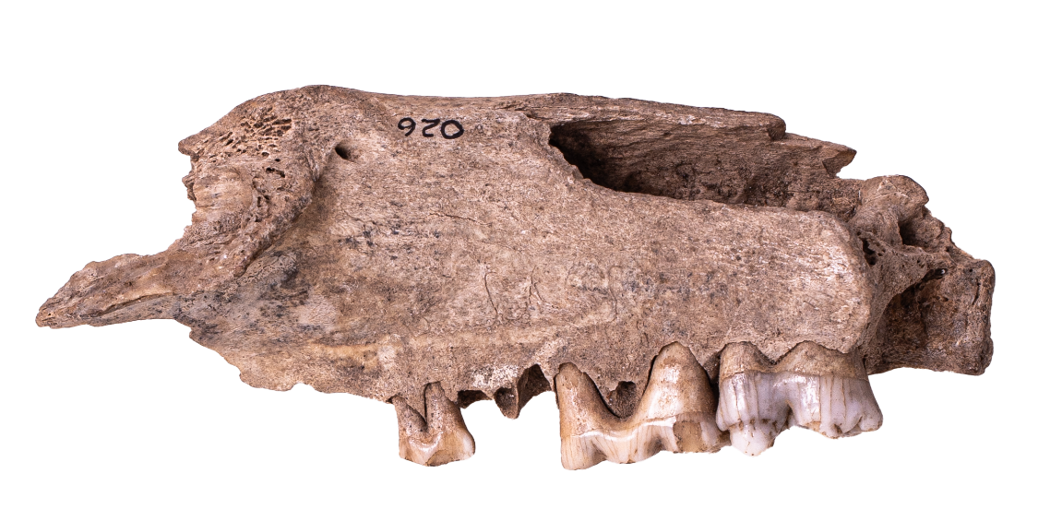
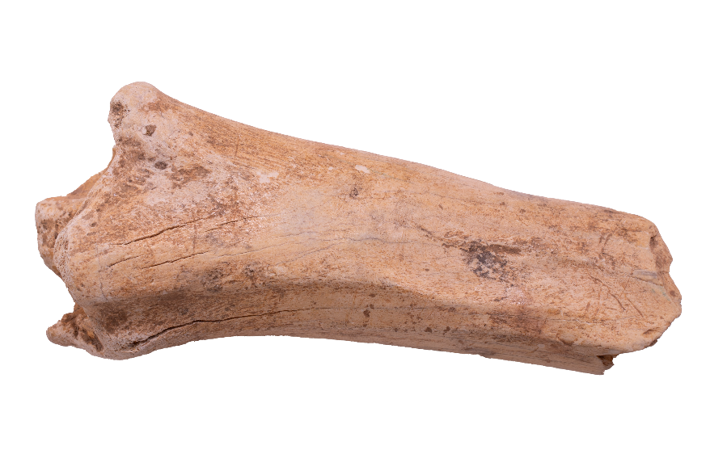
Places
These are all bones from animals found in Kendrick’s cave.
What happened here?
Dolphin Jaw
Ovis Jaw (type of sheep)
Cows tooth – right molar
Wild Boar jaw
Bison bone
Horse molar

Slide 7

Places
Kendrick’s Cave - What do you think this would be used for?
Bone Tally (made from deer bone)

Slide 8
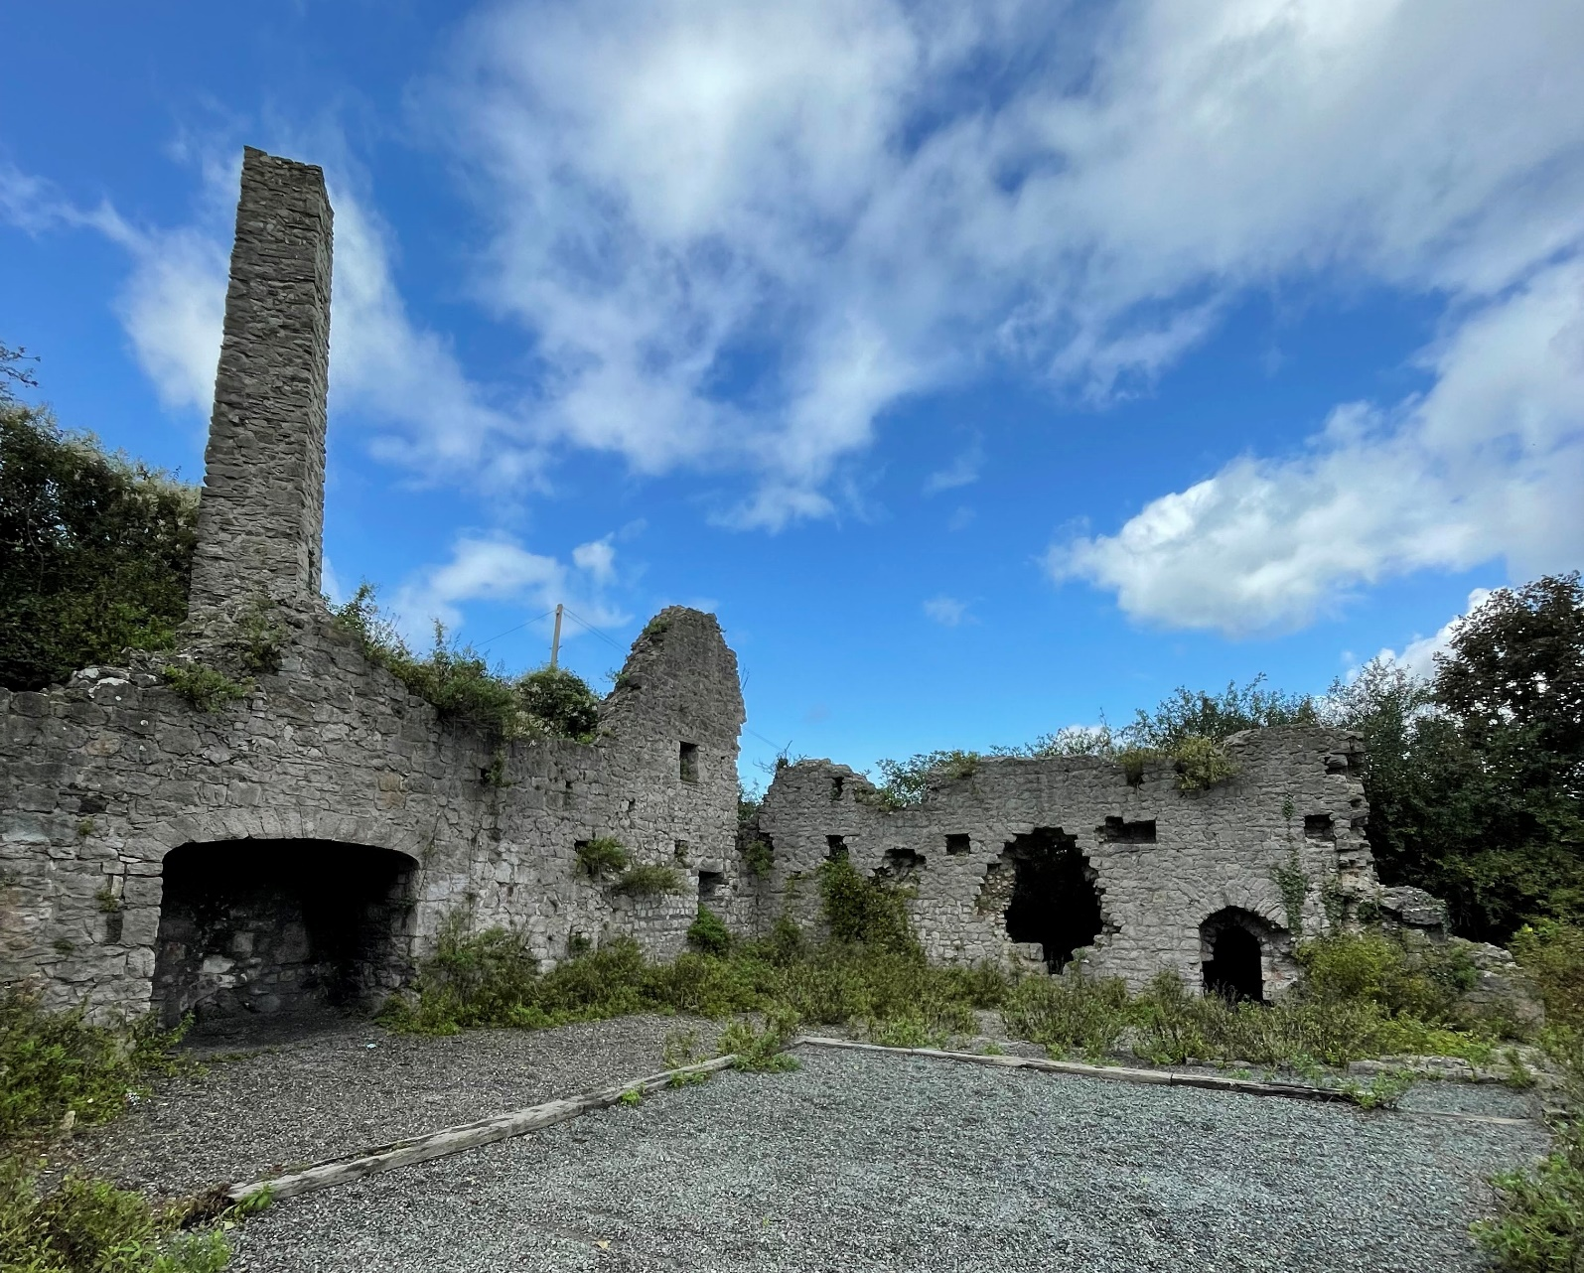
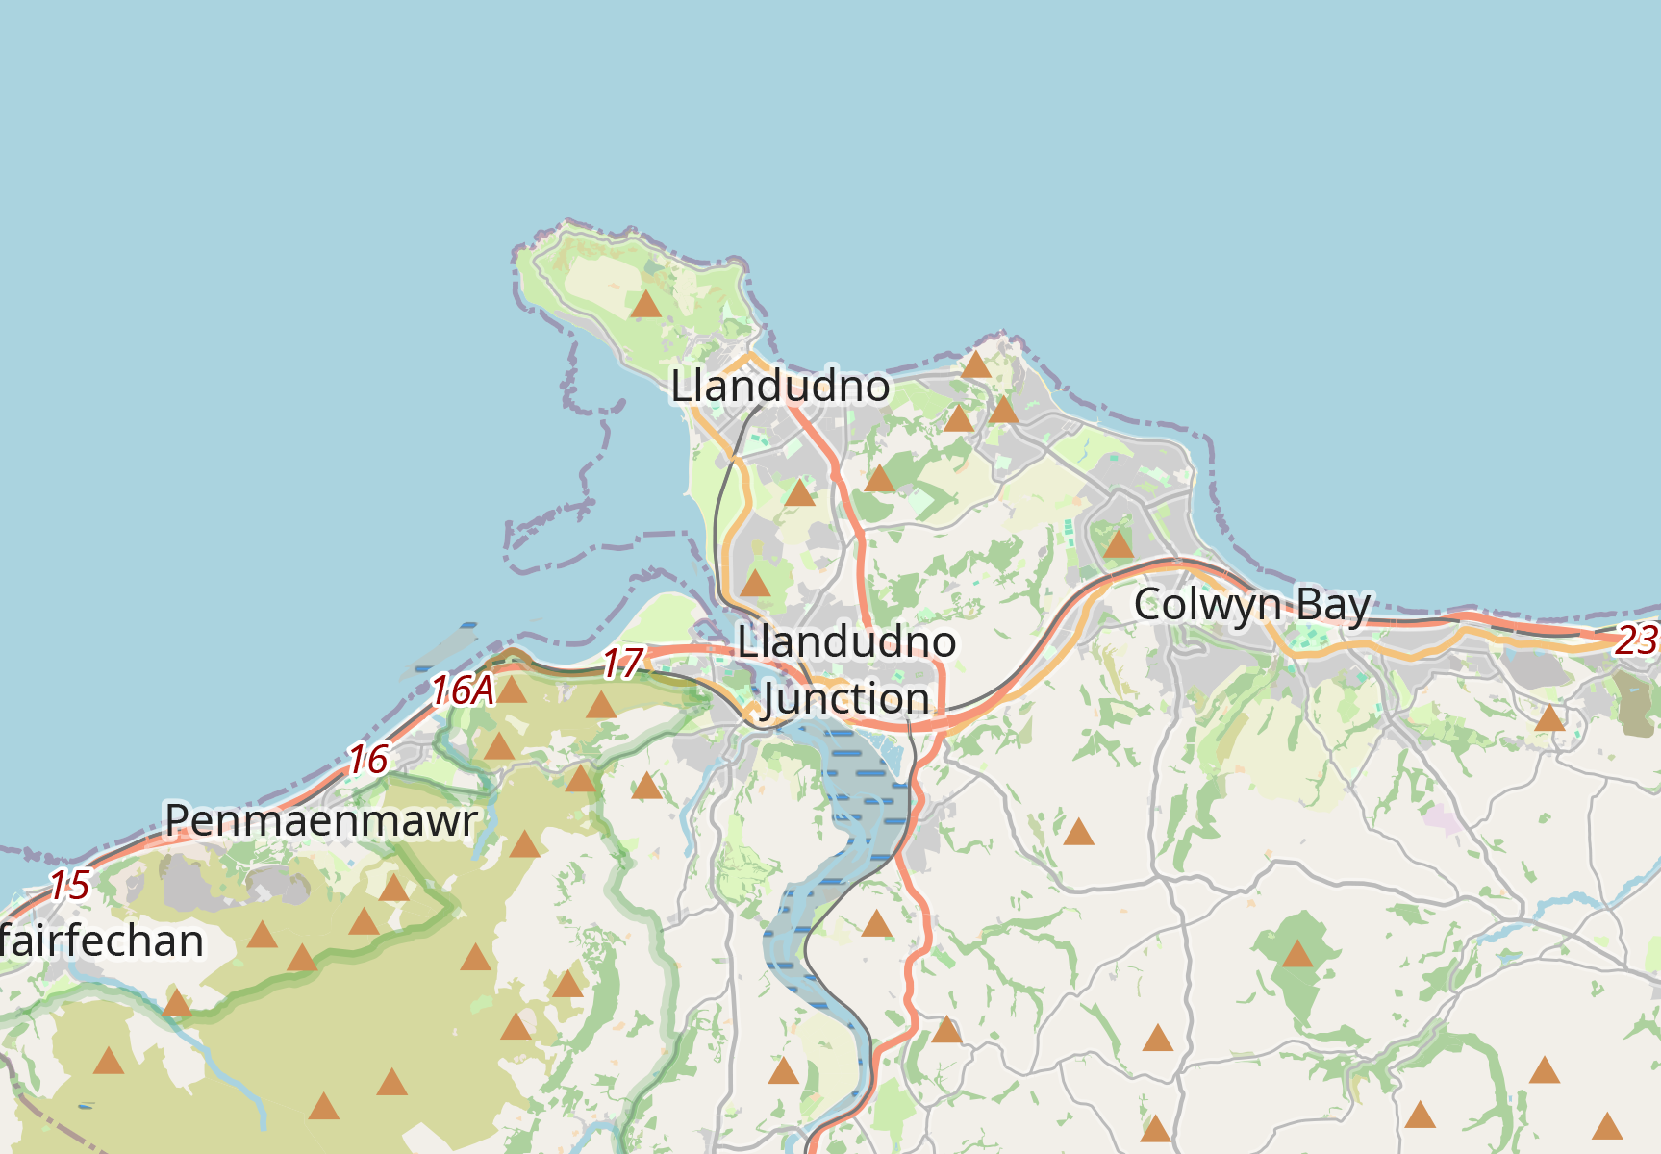
Places
Llys Euryn - What happened here?
Llys Euryn
Conwy

Slide 9
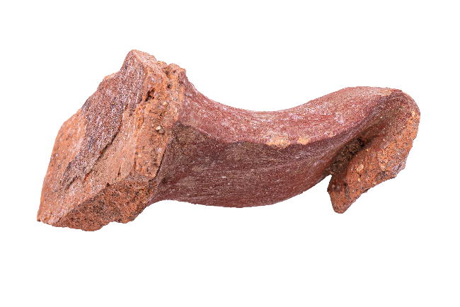
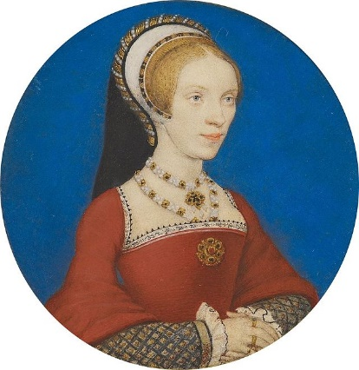
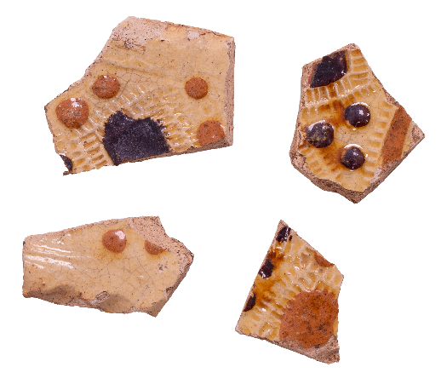
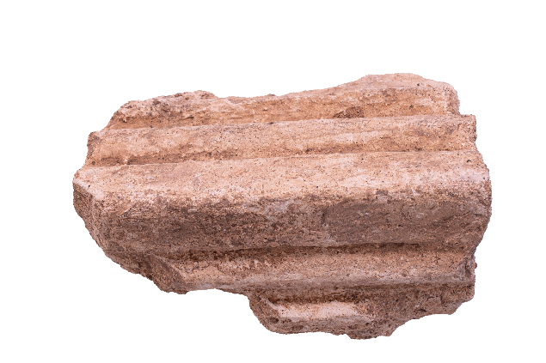
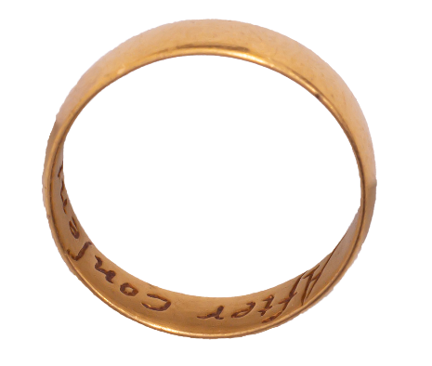
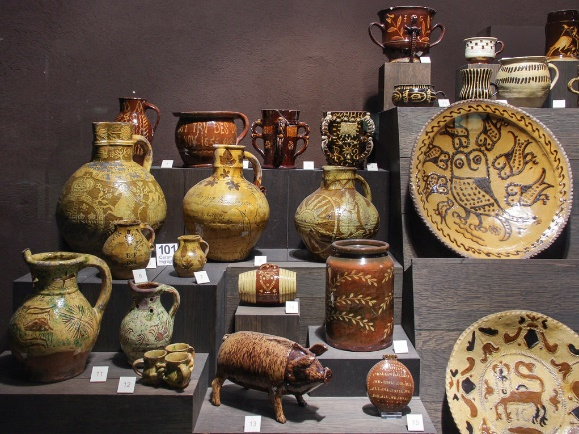
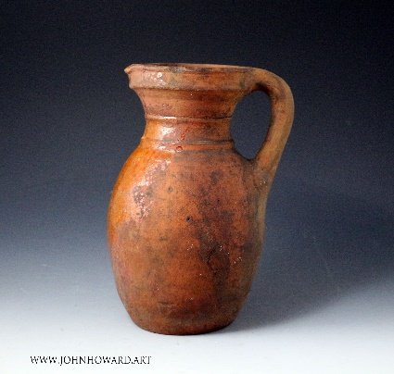
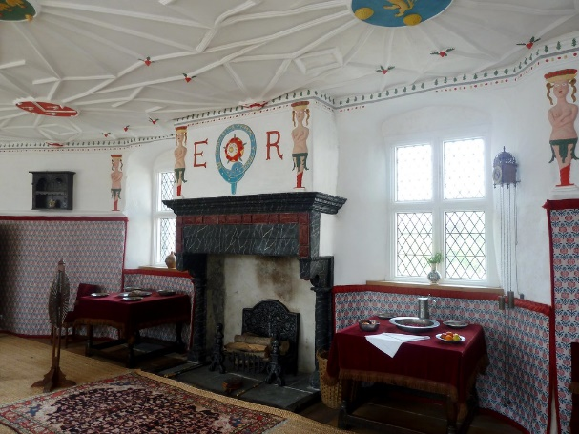
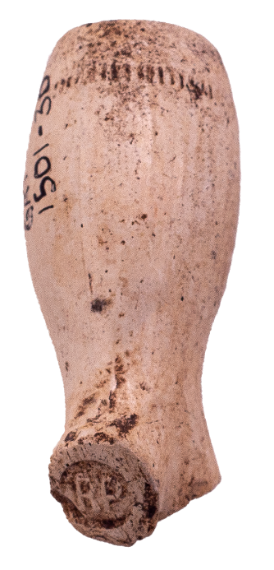
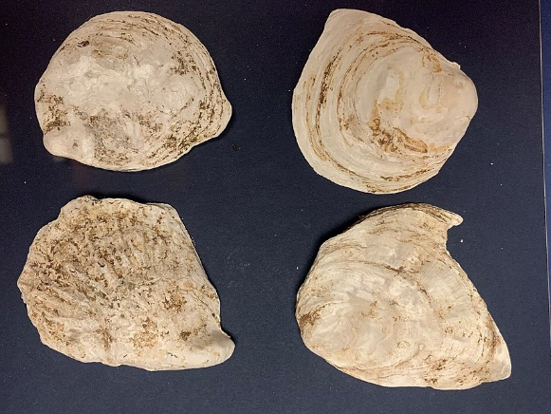
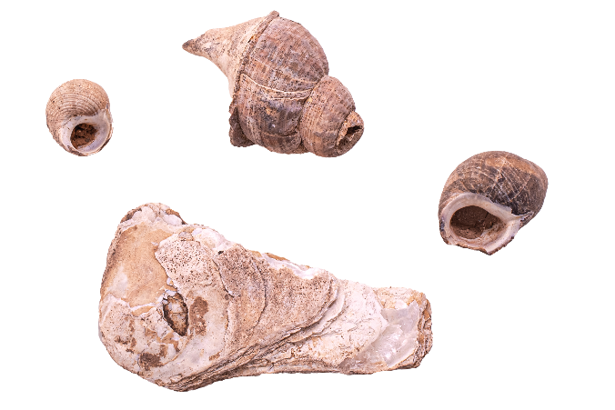
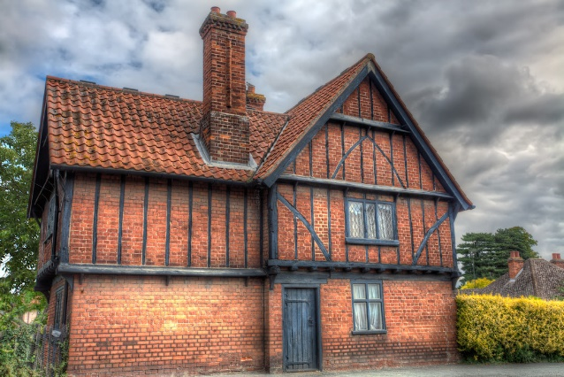
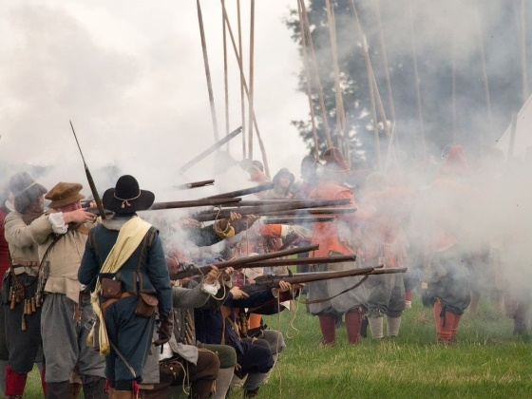
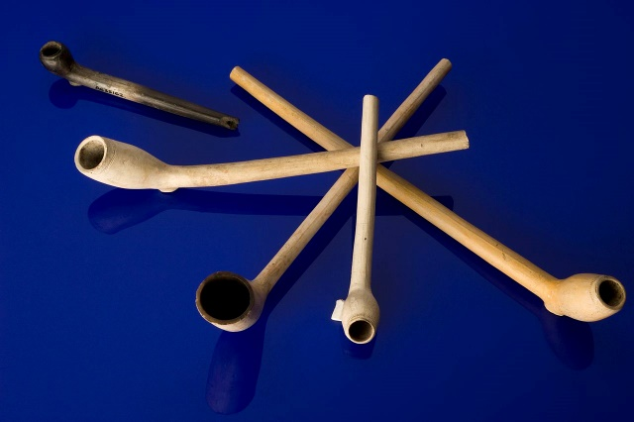
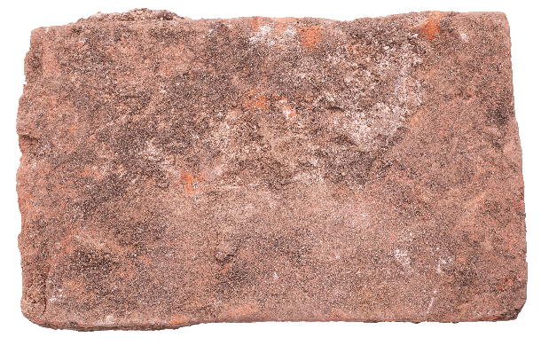
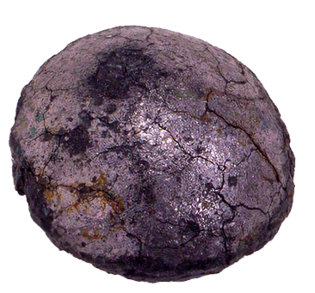
Places
Llys Euryn - What happened here?
1
Pottery Shards
2
Red pottery handle
3
Moulded ceiling plaster
4
Tudor ring
5
Shells
6
Tudor Brick
7
Lead shot/musket ball
8
Clay pipe

Slide 10
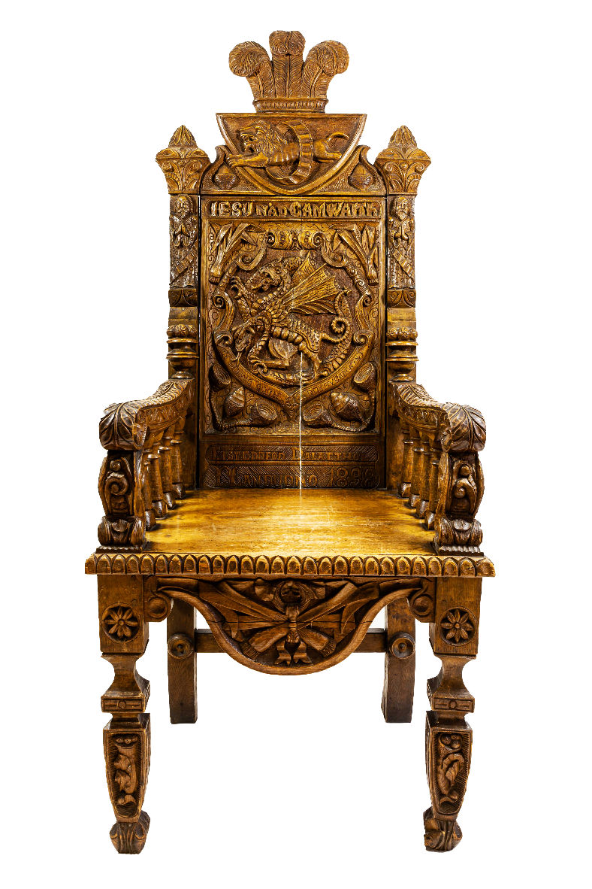
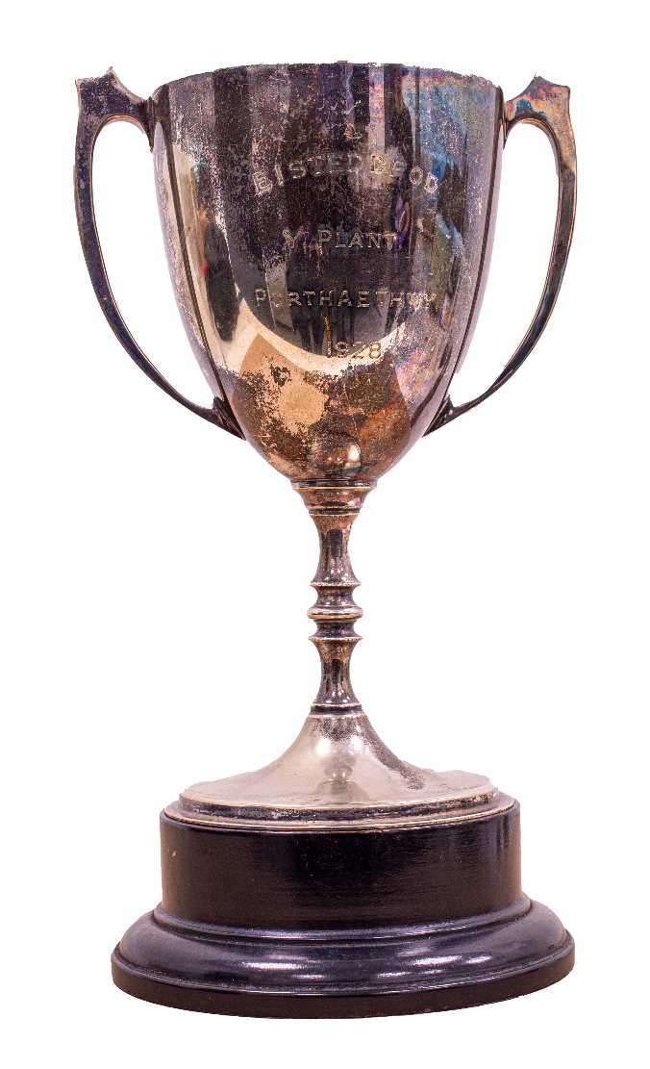
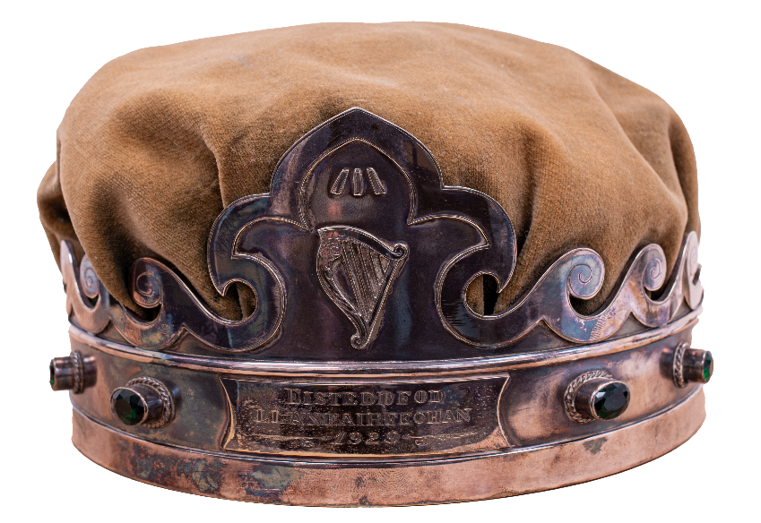
Events
Eisteddfod- What are these objects?
What do these objects tell us about the Eisteddfod?
Eisteddfod crown 1929
Eisteddfod cup 1928
Eisteddfod chair 1898

Slide 11
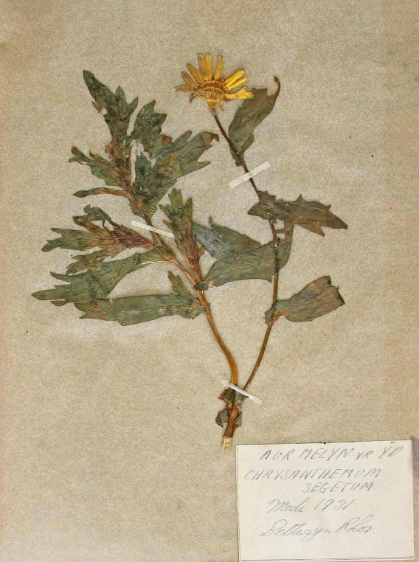
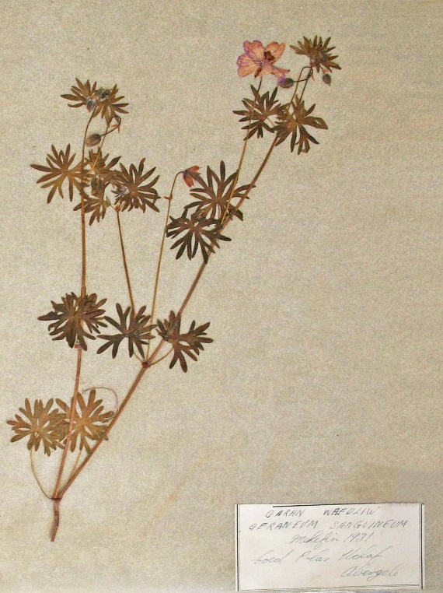
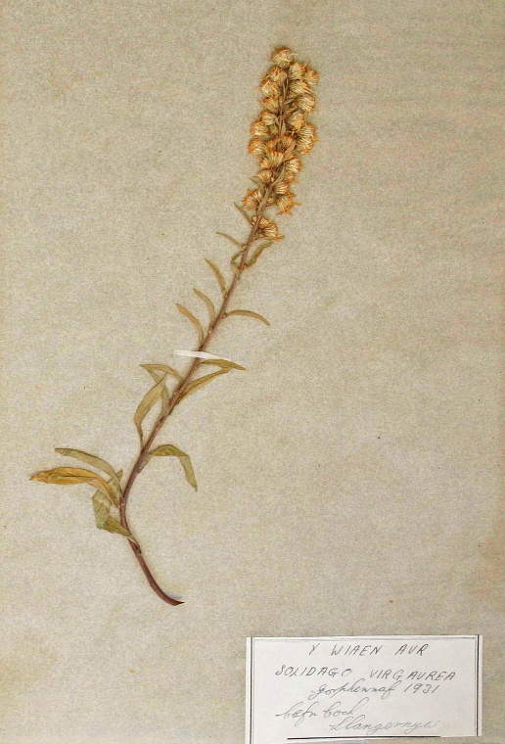
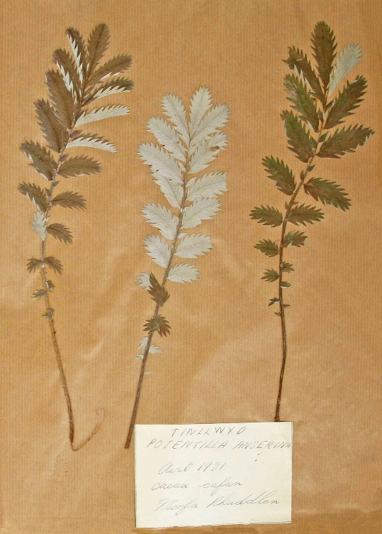
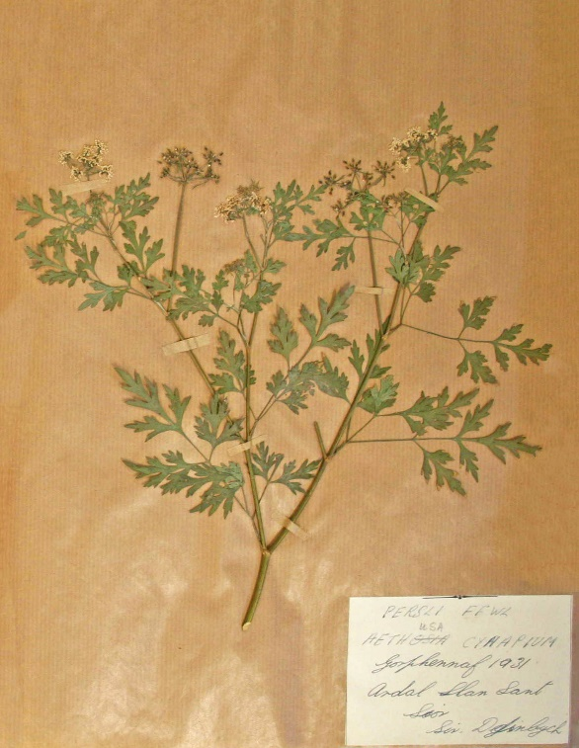
Events
Urdd Eisteddfod
What types of competitions are there in the Urdd Eisteddfod? (Today and the past)
Plant Book (Urdd Eisteddfod) 1932

Slide 12
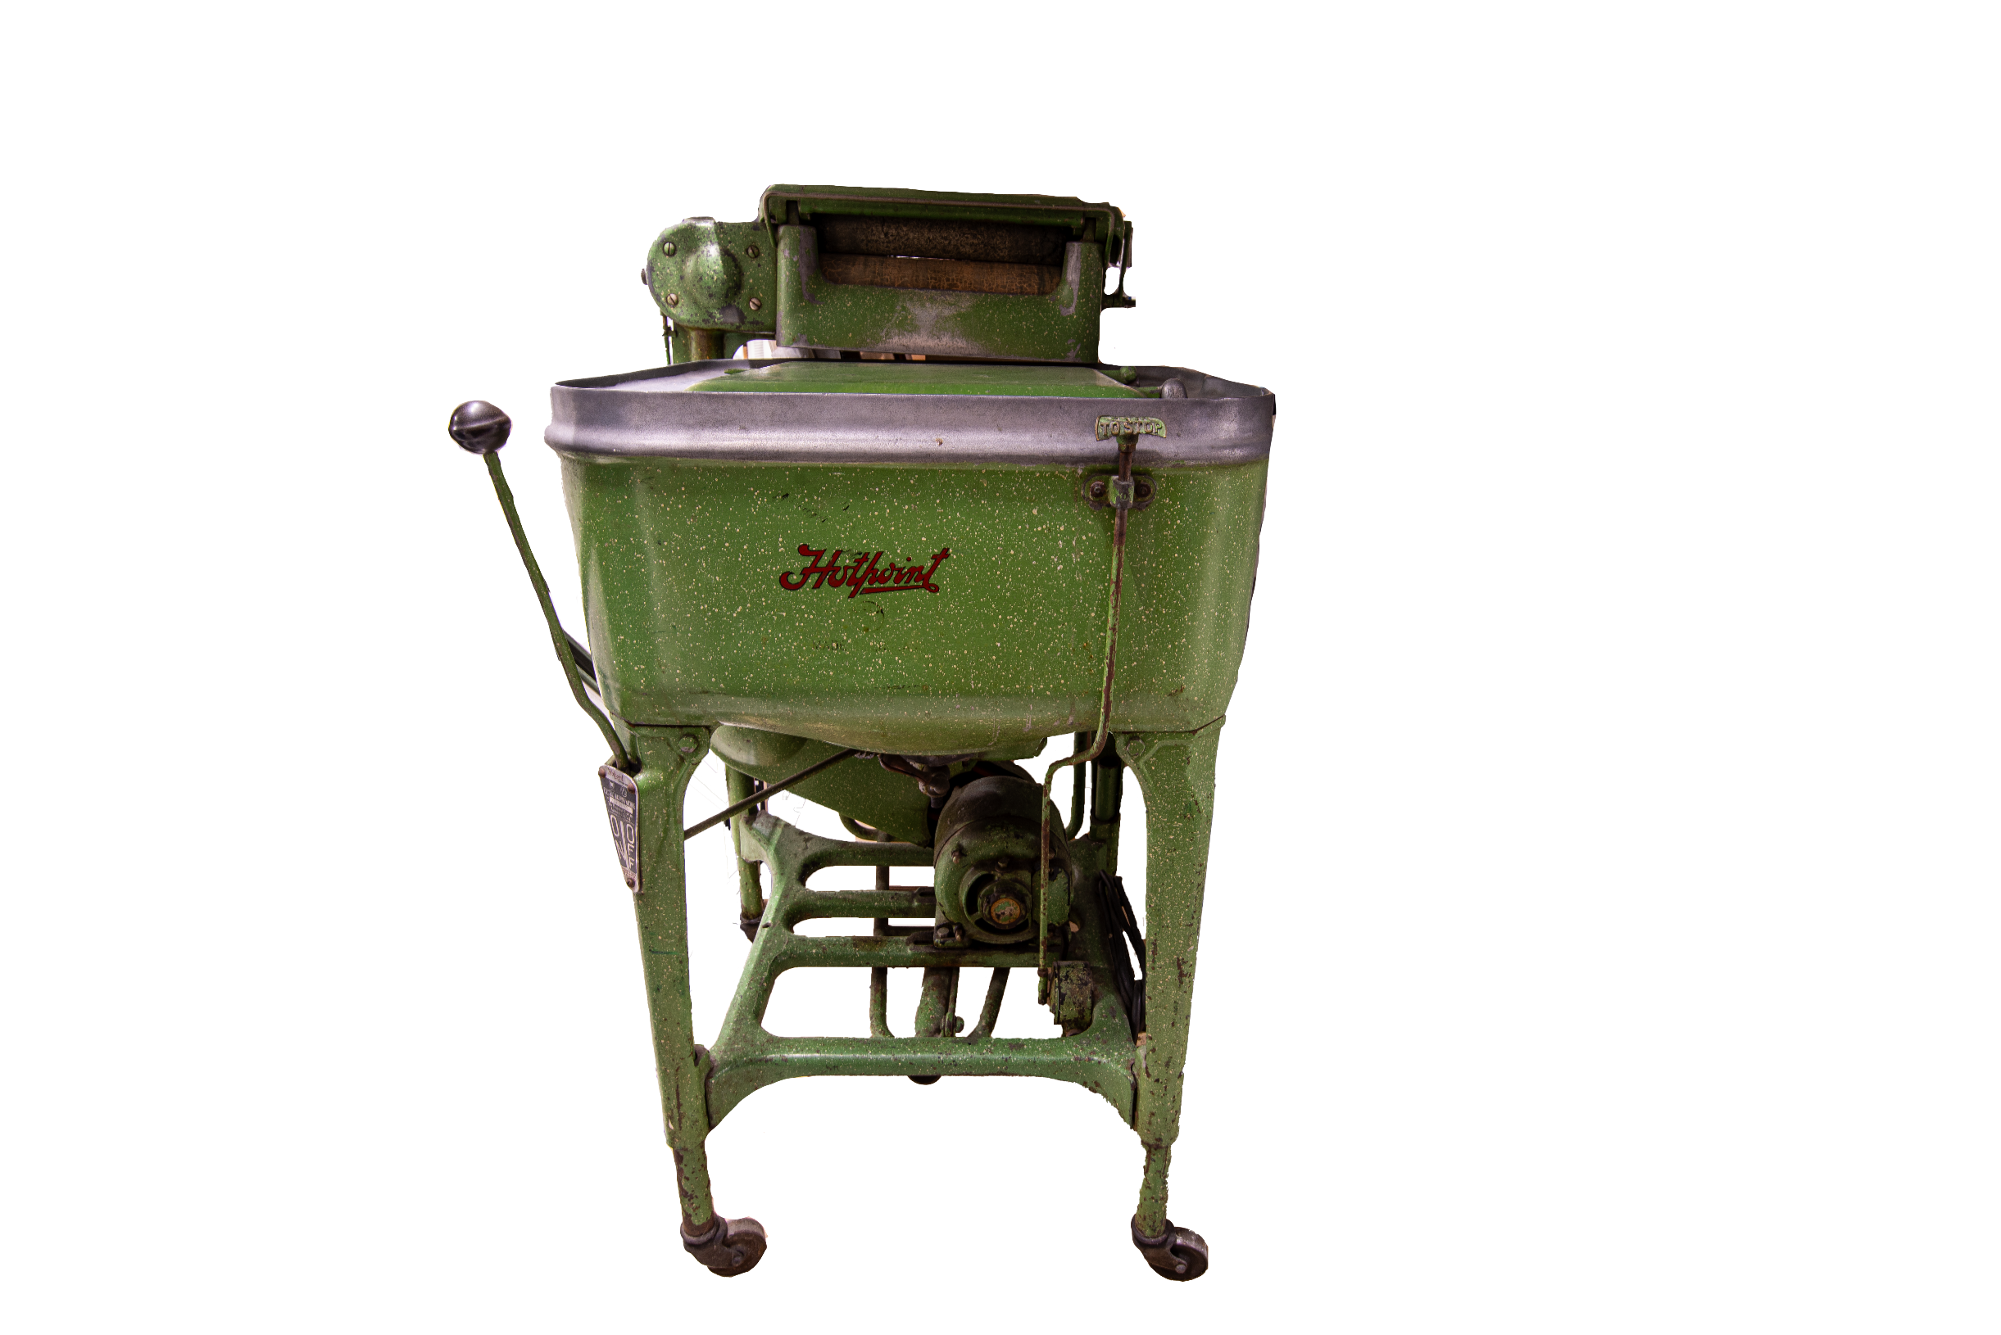









Museum Store Quiz 1
Click on three numbers and then guess the object! Click the rest to reveal the whole picture.
Notes:
Queen Elizabeth

Slide 13

Museum Store Quiz 2
Click on three numbers and then guess the object! Click the rest to reveal the whole picture.
Notes:
Queen Elizabeth

Slide 14
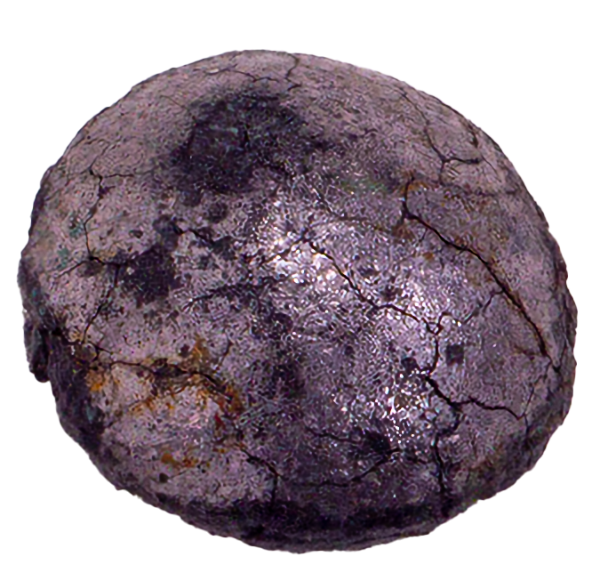
Museum Store Quiz 3
Click on three numbers and then guess the object! Click the rest to reveal the whole picture.
Notes:
Queen Elizabeth

Slide 15

Museum Store Quiz 4
Click on three numbers and then guess the object! Click the rest to reveal the whole picture.
Notes:
Queen Elizabeth

